Slide 1
Unit 4

Slide 2
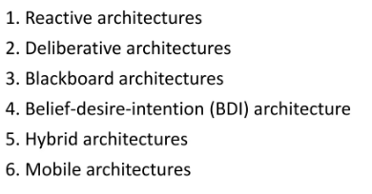
Architecture for Intelligent Agents
Based on the goals of agent application, a variety of agent architecture exist to help. This section will introduce some of the major architecture types and applications for which they can be used.

Slide 3
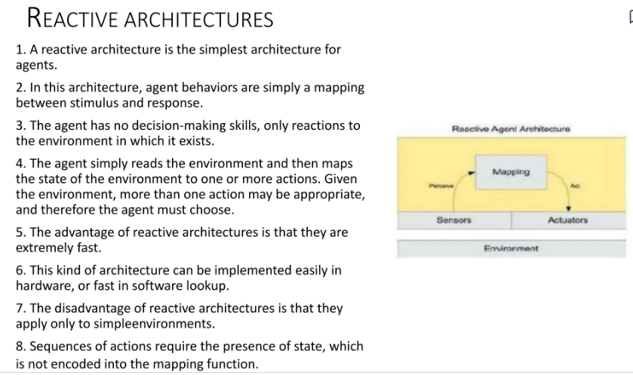

Slide 4
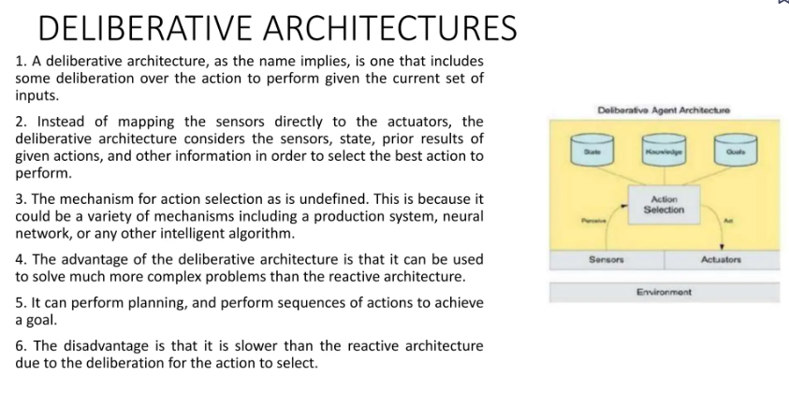

Slide 5
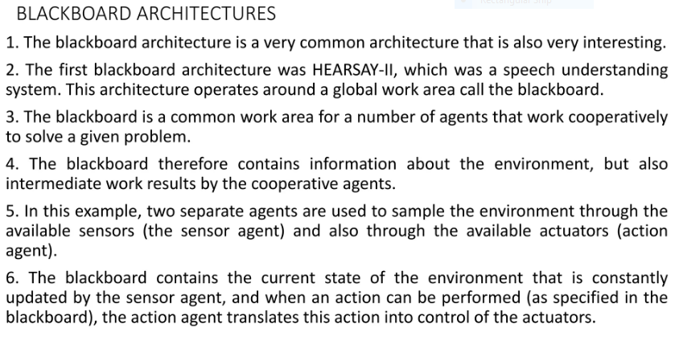

Slide 6
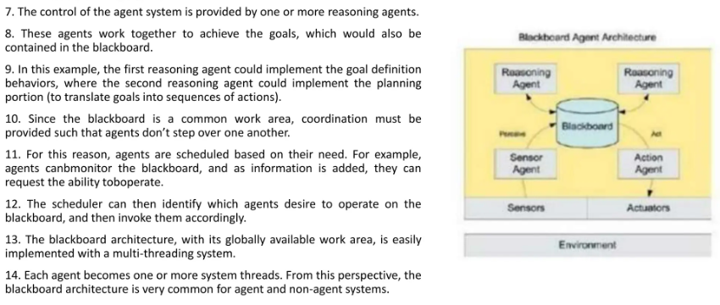

Slide 7
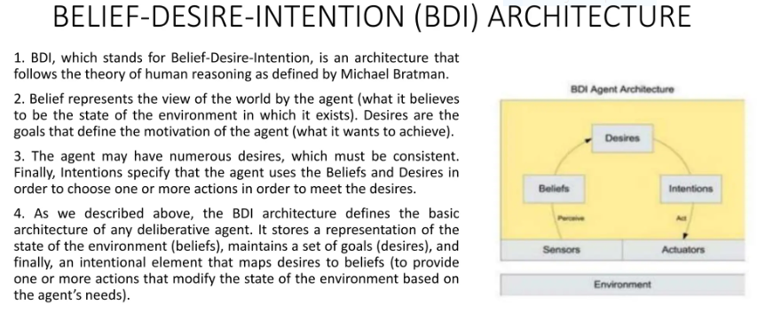

Slide 8
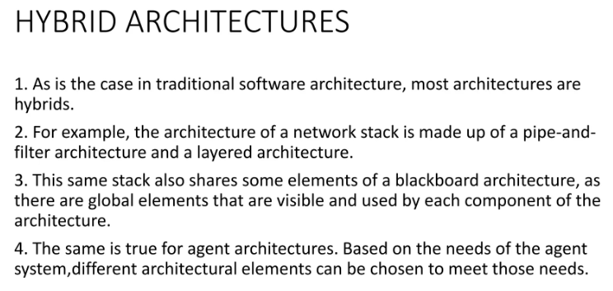

Slide 9
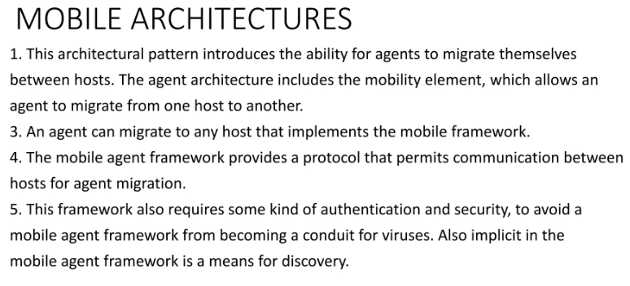

Slide 10
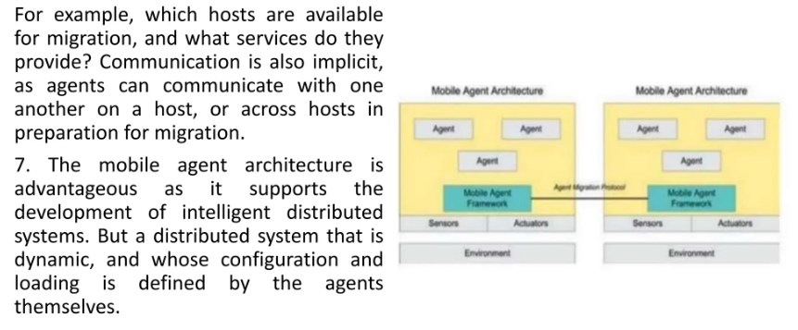

Slide 11
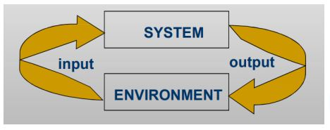
Agent Communication
Autonomous agents
An agent is a computer system capable of autonomous action in some environment in order to meet its design objectives.

Slide 12
Properties of Autonomous Agents
Situatedness: peceiving the environment via sensors and being able to affect the environment via effectors.
Autonomy: capability of action without intervention, and control over internal state.
Flexibility: ability to adapt and respond to various situations, tasks, or environments efficiently and effectively.
Responsiveness: respond in a timely fashion to change in the environment.
Pro-activity: actions which go beyond simple response to stimulus.
Sociability: ability to interact with other agents and humans for mutual benefit.

Slide 13
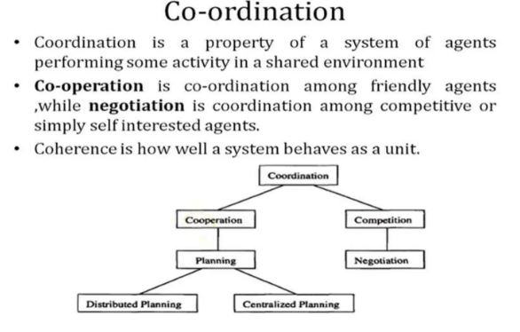

Slide 14
Co-operation
It the practice of working in common with mutually agreed-upon goals and possibly methods, instead of working separately in competition, and in which the success of one is dependent and contingent upon the success of another.
– E.g. I can't play a quintet alone!
When agents are working together, it is important to make a distinction between Benevolent agents and Self-interested agents.
It does not mean that they want to cause harm to other agents or that they care only about themselves. It means that it follows its interest as represented by a utility function.

Slide 15
Benevolent Agents
If we “own” the whole system, or are in a cooperative environment, we can design agents that help each other whenever asked (if possible)
In this case, we can assume agents are benevolent: others best interest is their best interest
Problem-solving in benevolent systems is called cooperative distributed problem solving (CDPS)
Benevolence simplifies the system design task enormously

Slide 16
Self-Interested Agents
If agents represent individuals or organizations, (the more general case), then we cannot make the benevolence assumption
Agents will be assumed to act to further their own interests, possibly at expense of others
Potential for conflict.
E.g. Competitive environment (sport, war, ...)
May complicate the design task enormously

Slide 17
Speech Act
Most treatments of communication in (multi-) agent systems borrow their inspiration from speech act theory
Speech act theories are pragmatic theories of language, i.e., theories of language use: they attempt to account for how language is used by people every day to achieve their goals and intentions
The origin of speech act theories are usually traced to Austin’s 1962 book, How to Do Things with Words

Slide 18
Different Aspects of Speech Act
Locutionary act: The simple speech act of generating sounds that are linked together by grammatical conventions so as to say something meaningful.
Illocutionary act: The speech act of doing something else – offering advice or taking a vow.
Perlocutionary act: The speech act of having an effect on those who hear a meaningful utterance.

Slide 19
In general, a speech act can be seen to have two components:
a performative verb: (e.g., request, inform, promise, … )
propositional content: (e.g., “the door is closed”)
Examples:
performative = request content = “the door is closed” speech act = “please close the door”
performative = inform content = “the door is closed” speech act = “the door is closed!”
performative = inquire content = “the door is closed” speech act = “is the door closed?”

Slide 20
Agent Communication Languages
We now consider agent communication languages (ACLs) — standard formats for the exchange of messages
The best known ACL is KQML, developed by the ARPA knowledge sharing initiative KQML is comprised of two parts:
the knowledge query and manipulation language (KQML)
the knowledge interchange format (KIF)

Slide 21
KQML and KIF
KQML is an ‘outer’ language, that defines various acceptable ‘communicative verbs’, or performatives Example performatives:
ask-if (‘is it true that. . . ’)
perform (‘please perform the following action. . . ’)
tell (‘it is true that. . . ’)
reply (‘the answer is . . . ’)
KIF is a language for expressing message content

Slide 22
KIF – Knowledge Interchange Format
Used to state:
Properties of things in a domain (e.g., “Noam is chairman”)
Relationships between things in a domain (e.g., “Amnon is Yael’s boss”)
General properties of a domain (e.g., “All students are registered for at least one course”)

Slide 23
KIF – Knowledge Interchange Format
“The temperature of m1 is 83 Celsius”: (= (temperature m1) (scalar 83 Celsius))
“An object is a bachelor if the object is a man and is not married”: (defrelation bachelor (?x) := (and (man ?x) (not (married ?x))))
“Any individual with the property of being a person also has the property of being a mammal”: (defrelation person (?x) :=> (mammal ?x))

Slide 24
KQML and KIF
In order to be able to communicate, agents must have agreed on a common set of terms
A formal specification of a set of terms is known as an ontology
The knowledge sharing effort has associated with it a large effort at defining common ontologies — software tools like ontolingua for this purpose
Example KQML/KIF dialogue… A to B: (ask-if (> (size chip1) (size chip2))) B to A: (reply true) B to A: (inform (= (size chip1) 20)) B to A: (inform (= (size chip2) 18))

Slide 25
SEVEN PROCESSES IN AGENT COMMUNICATION
Perception: Agents perceive their environment using sensors or by receiving messages from other agents.
Interpretation: Agents interpret the received information, extracting relevant data and understanding its meaning in the context of their goals and tasks.
Deliberation: Agents deliberate on the received information, making decisions and formulating plans based on their goals, beliefs, and preferences.
Action: Agents take actions based on their deliberation, which could involve sending messages to other agents, modifying their environment, or performing other tasks.
Communication: Agents communicate with each other by sending messages containing relevant information, requests, or responses.
Comprehension: Agents comprehend the messages received from other agents, understanding their content and implications.
Response: Agents respond to the messages they receive, either by taking appropriate actions, providing information, or engaging in further communication to clarify or negotiate.

Slide 26
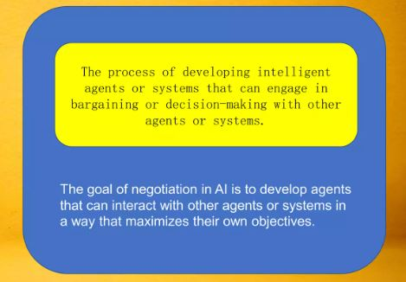
Negotiation

Slide 27
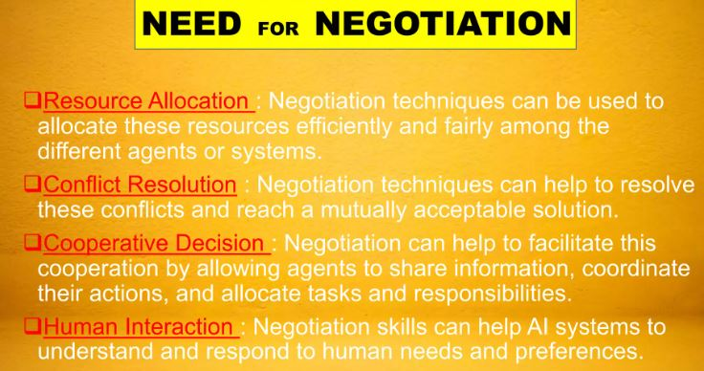

Slide 28
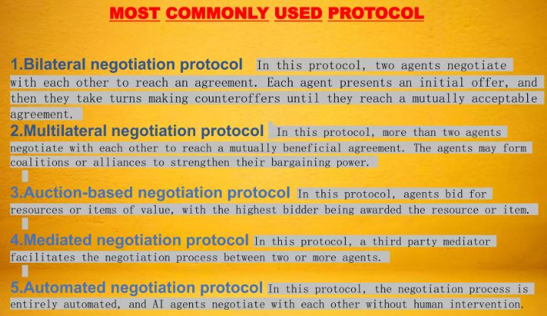

Slide 29
Negotiation
An example is the "Internet downloading domain," where each agent is given a list of documents that it must access over the Internet.
There is a cost associated with downloading, which each agent would like to minimize.
If a document is common to several agents, then they can save downloading cost by accessing the document once and then sharing it.

Slide 30
The environment might provide the following simple negotiation mechanism and constraints:
(1) each agent declares the documents it wants
(2) documents found to be common to two or more agents are assigned to agents based on the toss of a coin,
(3) agents pay for the documents they download, and
(4) agents are granted access to the documents they download. as well as any in their common sets. This mechanism is simple, symmetric, distributed, and efficient (no document is downloaded twice). To determine stability, the agents' strategies must be considered.

Slide 31
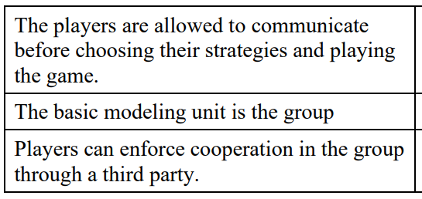
SINGLE-ISSUE NEGOTATION
Cooperative Game:

Slide 32
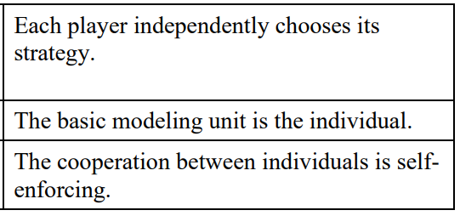
Non Cooperative Game:

Slide 33
MULTI-ISSUE NEGOTIATION
GAME-THEORETIC APPROACHES FOR MULTI-ISSUE NEGOTIATION
COOPERATIVE MODELS OF MULTI-ISSUE NEGOTIATION
NON-COOPERATIVE MODELS OF MULTI-ISSUE NEGOTIATION

Slide 34
GAME-THEORETIC APPROACHES FOR MULTI-ISSUE NEGOTIATION
The following are the four key procedures for bargaining over multiple issue:
Global bargaining:
Here, the bargaining agents directly tackle the global problem in which all the issues are addressed at once. In the context of non-cooperative theory, the global bargaining procedure is also called the package deal procedure. In this procedure, an offer from one agent to the other would specify how each one of the issues is to be resolved.

Slide 35
2. Independent/separate bargaining:
Here negotiations over the individual issues are totally separate and independent, with each having no effect on the other. This would be the case if each of the two parties employed m agents (for negotiating over m issues), with each agent in charge of negotiating one issue. For example, in negotiations between two countries, each issue may be resolved by representatives from the countries who care only about their individual issue.

Slide 36
3. Sequential bargaining with independent implementation:
Here the two parties consider one issue at a time. For instance, they may negotiate over the first issue, and after reaching an agreement on it, move on to negotiate the second, and so on. Here, the parties may not negotiate an issue until the previous one is resolved. There are several forms of the sequential procedure. These are defined in terms of the agenda and the implementation rule. For sequential bargaining, the agenda3 specifies the order in which the issues will be bargained. The implementation rule specifies when an agreement on an individual issue goes into effect. There are two implementation rules: the rule of independent implementation and the rule of simultaneous implementation.

Slide 37
4. Sequential bargaining with simultaneous implementation:
This is similar to the previous case except that now an agreement on an issue does not take effect until an agreement is reached on all the subsequent issues.

Slide 38
COOPERATIVE MODELS OF MULTI-ISSUE NEGOTIATION
Simultaneous implementation agenda independence: This axiom states that global bargaining and sequential bargaining with simultaneous implementation yield the same agreement.
Independent implementation agenda independence: This axiom states that global bargaining and sequential bargaining with independent implementation yield the same agreement.
Separate/global equivalence: This axiom states that global bargaining and separate bargaining yield the same agreement.

Slide 39
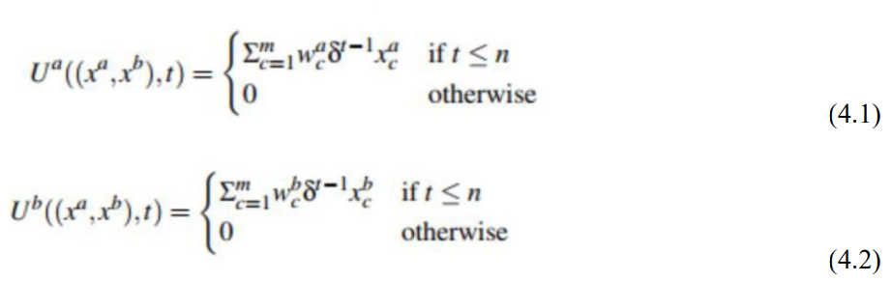
NON-COOPERATIVE MODELS OF MULTI-ISSUE NEGOTIATION
An agent’s cumulative utility is linear and additive. The functions Ua and Ub give the cumulative utilities for a and b respectively at time t and are defined as follows.
If wa c> wa c+1, then agent a values issue c more than issue c+ 1. Like for agent b.

Slide 40
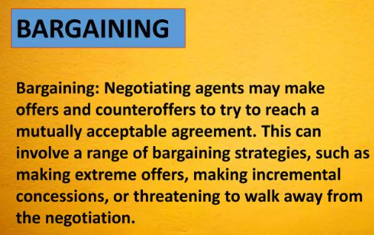

Slide 41
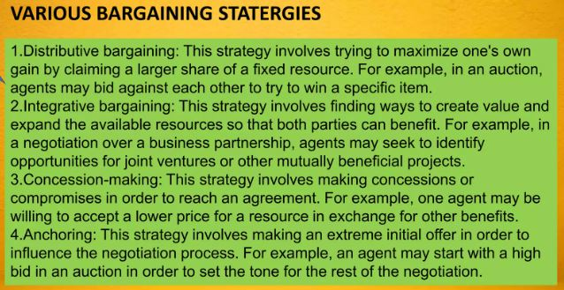

Slide 42
ARGUMENTATION AMONG AGENTS
Argumentation can be defined as an activity aimed at convincing of the acceptability of a standpoint by putting forward propositions justifying or refuting the standpoint.
Argument: Reasons / justifications supporting a conclusion
It is represented as: support ->conclusion

Slide 43
Informational arguments: Beliefs -> Belief e.g. If it is cloudy, it might rain.
Motivational arguments : Beliefs, Desires ->Desire e.g. If it is cloudy and you want to get out then you can get wet.
Practical arguments: Belief, Sub-Goals -> Goal e.g. If it is cloudy and you own a raincoat then put the raincoat.
Social arguments: Social commitments-> Goal, Desire e.g1. I will stop at the corner because the law say so.
e.g2. I can’t do that, I promise to my mother that won’t.

Slide 44
Process of Argumentation
1. Given the definition of arguments over a content language (and its logic), the models allow to:
• Compute interactions between arguments: attacks, defeat, support,...
• Valuation of arguments: assign weights to arguments in order to compare them.
Intrinsic value of an argument(Intrinsic Value refers to the inherent quality or merit of an argument)
Interaction-based value of an argument(Interaction-based Value refers to the value of an argument)
2. Selection of acceptable argument (conclusion)
• Individual acceptability
• Collective acceptability

Slide 45
1. Constructing arguments (in favor of / against a “statement”) from available information.
A: “Tweety is a bird, so it flies”
B: “Tweety is just a cartoon!”
2. Determining the different conflicts among the arguments.
“Since Tweety is a cartoon, it cannot fly!” (B attacks A)
Evaluating the acceptability of the different arguments
“Since we have no reason to believe otherwise, we’ll assume Tweety is a cartoon.” (accept B). “But then, this means despite being a bird he cannot fly.” (reject A).
3. Concluding, or defining the justified conclusions.
“We conclude that Tweety cannot fly!”

Slide 46
Trust and Reputation in MAS
Trust:
Trust refers to the belief or confidence that one agent has in another's ability, reliability, and intention to perform actions as expected.
Trust is fundamental in scenarios where agents must depend on each other to achieve their goals.
Key Aspects of Trust(Ensuring Trust):
Direct Trust: Derived from direct interactions between agents. If an agent consistently performs well in transactions, it builds a high level of direct trust.
Indirect Trust: Inferred from the experiences and recommendations of other agents. If Agent A trusts Agent B, and Agent B trusts Agent C, Agent A might also trust Agent C to some extent (transitive trust).
Contextual Trust: Trust can vary depending on the context or specific type of task. An agent might be highly trusted for financial transactions but not for data sharing.

Slide 47
Trust can be computed as:
1. A binary value (1=‘I do trust this agent’, 0=‘I don’t trust this agent’)
2. A set of qualitative values or a discrete set of numerical values (e.g. ‘2’, ‘1’, ‘0’, ‘-1’, ‘-2’)
3. A continuous numerical value (e.g. [-300..300])
4. A probability distribution
5. Degrees over underlying beliefs and intentions (cognitive approach)

Slide 48
Reputation:
Reputation is a collective measure of an agent's trustworthiness, derived from the opinions and experiences of other agents within the system.
It serves as a social metric that helps agents make informed decisions about future interactions.
Key Aspects of Reputation(Ensuring Reputation):
Reputation Score: A quantitative measure that aggregates feedback from multiple agents to reflect an agent's overall trustworthiness.
Feedback Mechanisms: Agents provide feedback based on their interactions, which is used to update reputation scores.
Aggregation Techniques: Methods like weighted averages, Bayesian inference, or machine learning algorithms are used to combine feedback into a coherent reputation score.
Public and Private Reputations: Reputation information can be public (accessible to all agents) or private (restricted to specific agents or groups).

Slide 49
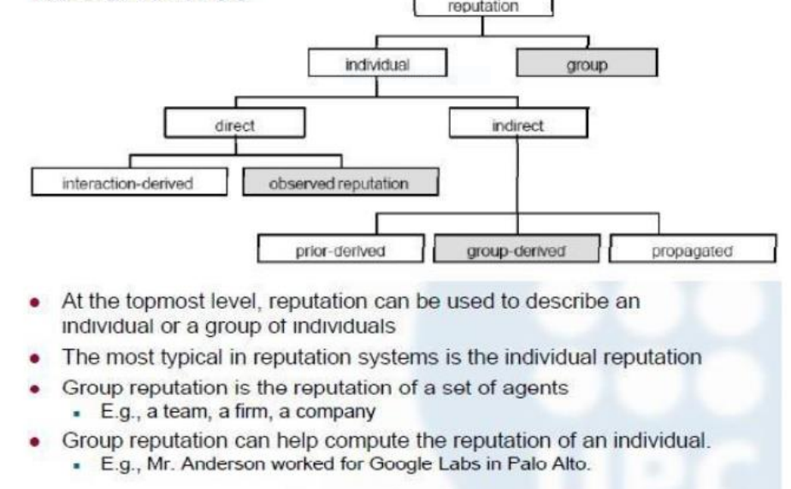

Slide 50
Ensuring Trust and Reputation in MAS
Machine Learning Algorithms: Techniques like reinforcement learning can adapt trust assessments based on the outcomes of interactions over time.
Game-Theoretic Approaches: Model interactions as games where trust and reputation can influence strategy and decision-making.
Smart Contracts: These can automate and enforce trust-related agreements and reputation updates based on predefined rules.
Trust Propagation: Using the structure of social networks to propagate trust values through connected agents.
Community Detection: Identifying trustworthy communities or sub-groups within the larger network of agents.
Anomaly Detection: Monitoring agents' behavior for deviations from expected patterns, which might indicate untrustworthiness or malicious intent.
Hybrid Approaches: Combining multiple techniques to enhance the robustness and accuracy of trust and reputation mechanisms.

Slide 51
Tools for MAS
Here are some of the prominent tools and frameworks used for developing and studying multi-agent systems in AI:
JADE (Java Agent DEvelopment Framework)
Description: JADE is a popular open-source platform for developing multi-agent systems in Java. It simplifies the implementation of agents through a comprehensive set of libraries and tools.
Features: Provides a FIPA-compliant agent platform, agent communication language (ACL), and directory facilitator services.

Slide 52
NetLogo:
Description: NetLogo is a programmable modeling environment for simulating natural and social phenomena. It is particularly well-suited for modeling complex systems that evolve over time.
Features: Provides a simple yet powerful language for defining agent behaviors, a rich graphical interface, and extensive libraries for various simulation scenarios.
Repast (Recursive Porous Agent Simulation Toolkit):
Description: Repast is a family of agent-based modeling and simulation platforms. It supports both large-scale and individual-based modeling.
Features: Includes Repast Simphony, Repast for High Performance Computing (Repast HPC), and Repast for Python (Repast Py), catering to different simulation needs.

Slide 53
GAMA (GIS Agent-based Modeling Architecture):
Description: GAMA is a platform for developing spatially explicit agent-based simulations. It is highly suitable for integrating geographic information system (GIS) data.
Features: Supports complex environment representations, agent behaviors, and interaction with real-world data.
MATLAB/Simulink:
Description: MATLAB, along with its toolboxes such as Simulink, can be used for developing and simulating multi-agent systems, particularly those involving control systems and robotics.
Features: Provides extensive mathematical and graphical capabilities, as well as specialized toolboxes like the Robotics System Toolbox.

Slide 54
PyMARL (Python Multi-Agent Reinforcement Learning):
Description: PyMARL is a framework for research in multi-agent reinforcement learning, implemented in Python.
Features: Designed to facilitate the development and evaluation of MARL algorithms with a focus on StarCraft II as a testbed.
SUMO (Simulation of Urban MObility):
Description: SUMO is an open-source traffic simulation suite, which can be used to model and analyze traffic flow and transportation systems as multi-agent systems.
Features: Supports modeling of large-scale traffic networks, vehicle communication, and integration with other simulation tools.

Slide 55
Unity ML-Agents Toolkit:
Description: Unity ML-Agents provides a toolkit for creating intelligent agents using the Unity game engine, which is popular for developing 3D environments.
Features: Supports reinforcement learning, imitation learning, and self-play, with a strong focus on high-quality visual environments.
BURLAP (Brown-UMBC Reinforcement Learning and Planning):
Description: BURLAP is a Java library for developing and evaluating single and multi-agent learning algorithms.
Features: Offers a range of tools for modeling Markov decision processes, planning algorithms, and learning algorithms.

